Slide 1
AIMAS Final Report
Age-related Macular Degeneration Detection
資工 113 – 李泓均

Slide 2
Original
Lung nodule detection
Dataset – Luna16
Model – yolov4, U-Net, 3D-CNN, CT-GAN

Slide 3
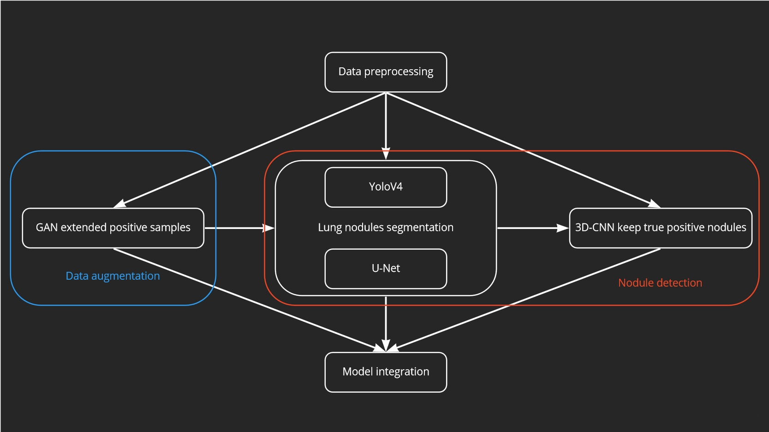
Project architecture

Slide 4
Afterword
AMD detection
Dataset – iChallenge-AMD
Model – ResNet50
Frame - fastai

Slide 5
Data structure
Data structure for saving training datas
AMD_Data
├── Training400
│ ├── AMD - With AMD (89)
│ ├── Non-AMD - Without AMD (311)
│ └── models
└── Training400-Lesion
├── Lesion_Illustration - AMD Illustration
└── Lesion_Masks - All kind AMD masks (400)
├── drusen - (61)
├── exudate - (38)
├── hemorrhage - (19)
├── others - (17)
└── scar - (13)

Slide 6
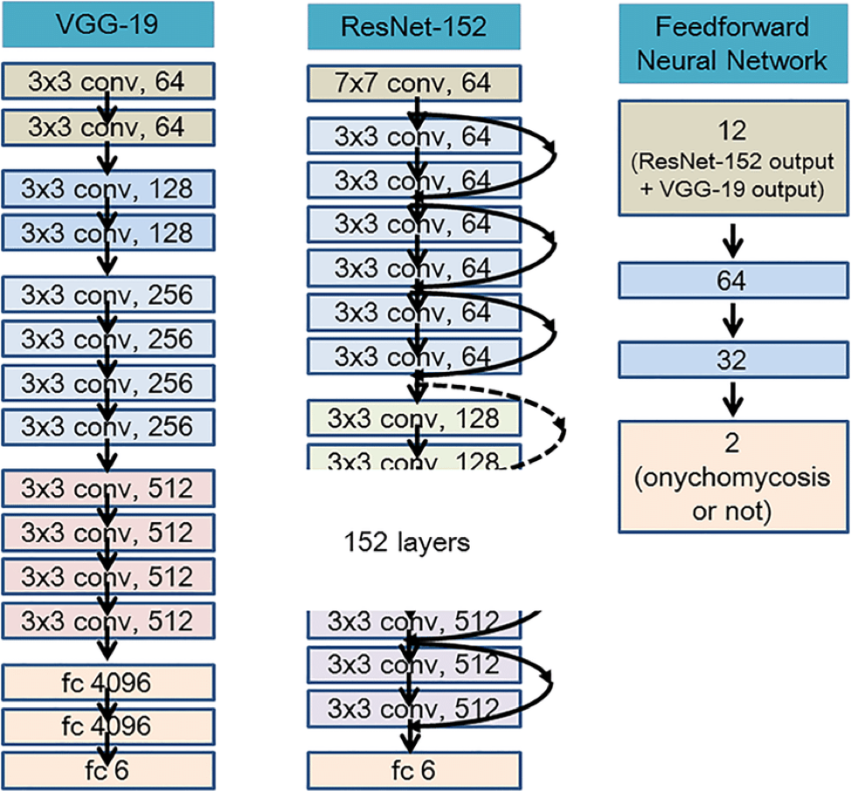
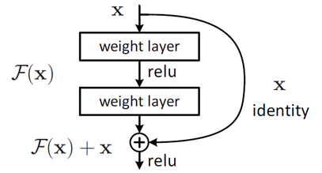
ResNet50
Architecture
H(X) = F(x) + x

Slide 7
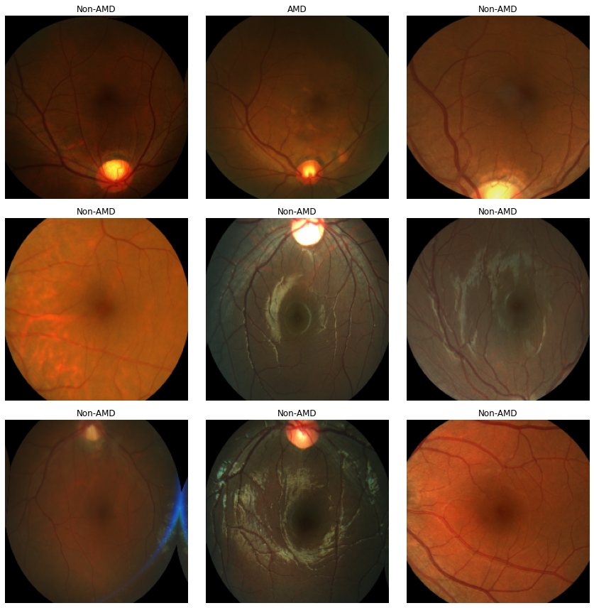
Classification
Preprocessing
What have done
Resize 224x224
Transform
Label
Set batch
Random shuffle

Slide 8
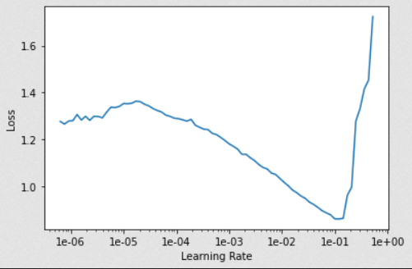

Learning rate setting
Let fastai find LR automatically
Auto find learning rate

Slide 9
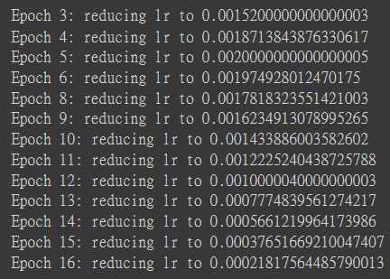
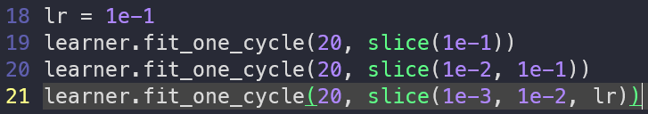
Differential Learning rates
Learning rate annealing

Slide 10
Differential Learning rates
How to set
Small difference => [1e-2*LR, 1e-1*LR, LR]
Big difference => [LR/9, LR/3, LR]

Slide 11
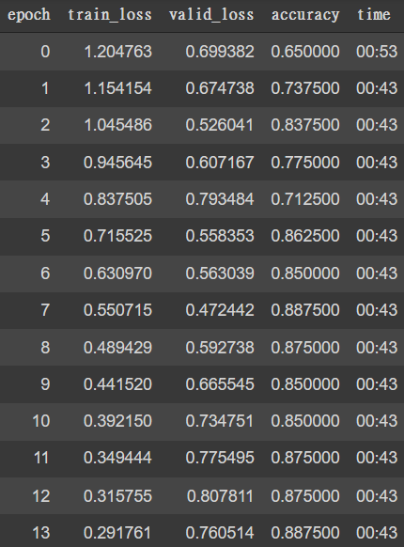
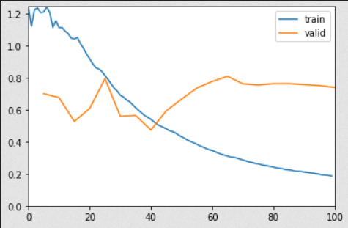
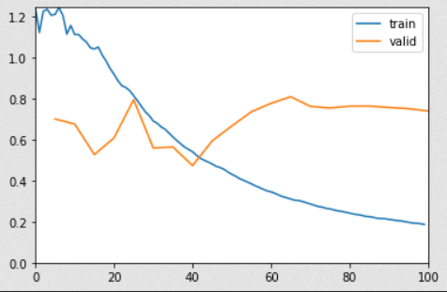
Training
Training result after 20 epochs

Slide 12
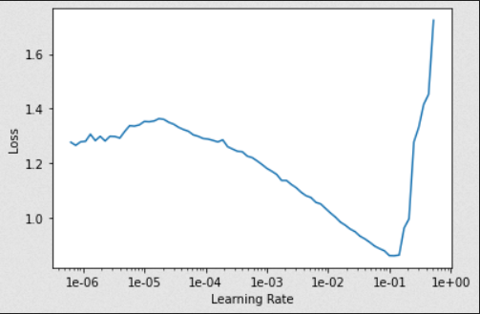
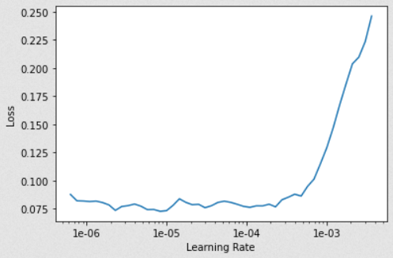
Unfreeze model
Adjustment parameter
Origin Model After unfreeze model

Slide 13
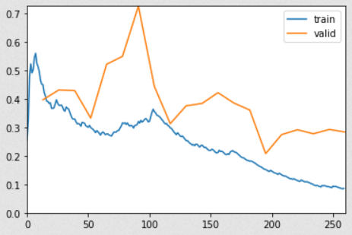
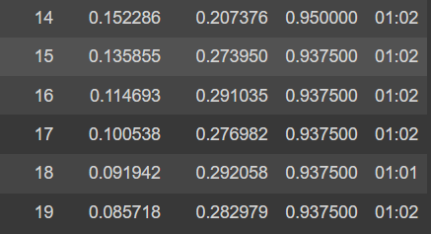
Final Result
ACC & loss

Slide 14
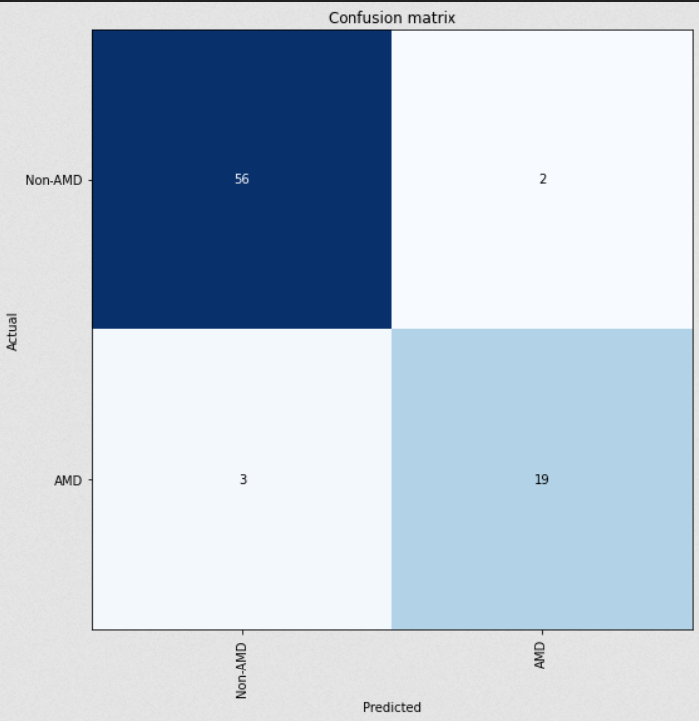
Evaluation
Confusion matrix

Slide 15
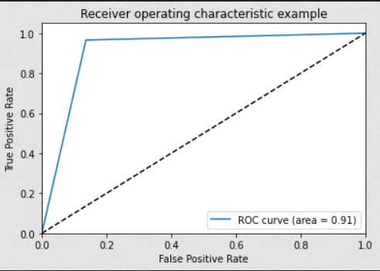
Evaluation
ROC
ROC curve – area = 0.91

Slide 16
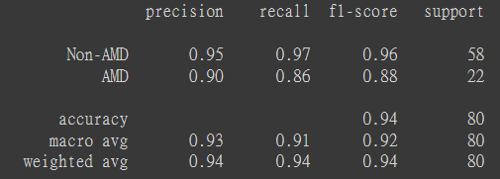
Evaluation
report

Slide 17
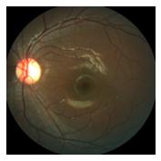
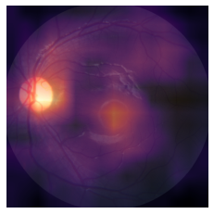
Evaluation
Heatmap

Slide 18
THANK YOU!
Any Questions?
CSIE - arashi87

